Slide 1
Annotation base Configuration
Compiler: Lê Anh Vũ
Email: levu@yahoo-corp.jp

Slide 2
Agenda
Spring Annotation Base
Some important annotation
Example Annotation- @Configuration & @Bean
Example Annotation- @Import

Slide 3
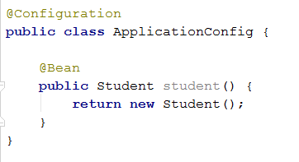
Spring Annotation Base
Support creating the Spring configuration not use XML

Slide 4
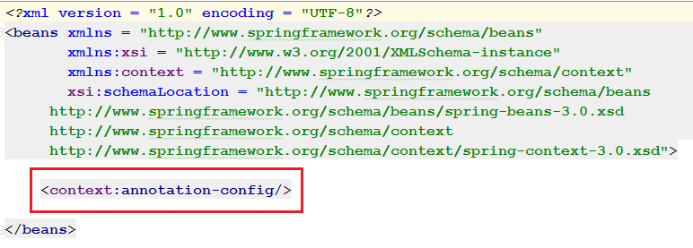
Spring Annotation Base
By default Spring Annotation is turned off -> turn on before using

Slide 5
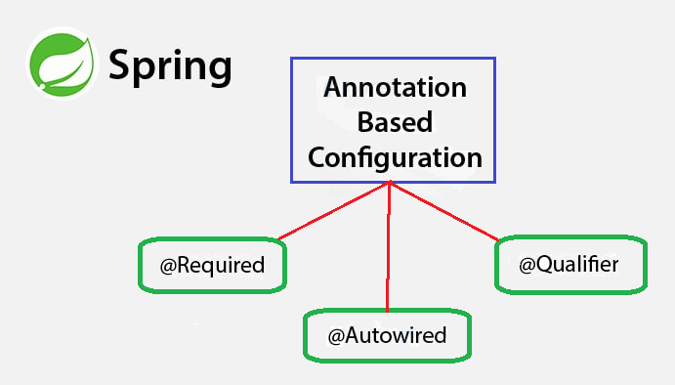
Some important annotation
@Required
@Autowired
@Qualifier

Slide 6
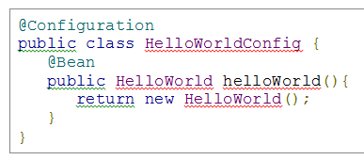

Example Annotation- @Configuration & @Bean
The above code is equivalent to the following XML content

Slide 7
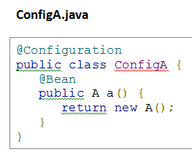
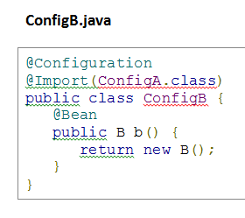
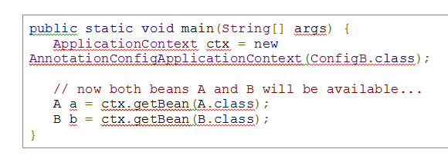
Example Annotation- @Import

